Slide 1

Online Quiz Application
Guided By :-
Presented By :-
Mr. Ashish Saxena
Kapil Kumar , Mahak Alvi , Jugendra , Prasang Kumar

Slide 2
Introduction
The ‘Online Quiz Application’ project will be developed to overcome the time consuming problem of manual system. Apart from that in current system, checking the answer sheets after taking test, waste the examiners time, so this application will check the correct answer and save the examiner time and carry the examination in an effective manner. The users which are use this system don’t need to high computing knowledge and also system will inform them while entering invalid data.

Slide 3
Objectives
The objective of this project is to manage the details of students, examinations, marks, courses and papers in a good manner. The performance of the application will be fully control by administrator and administrator can guaranty any one to access. The project will reduce the manual process in managing examinations and all issues regarding that.

Slide 4
Problem Statements
In this quiz application which is designed and implemented in Python we try to overcome the existing problems with following features:
To Remove source confuse issue
For Better management
For Connection to database for better storing of data
To Better frontend management
To Better backend management
To Try to decrease error issuer during runtime.

Slide 5
Methodology
The methodology of developing of project will be a step-by-step sequence to design, develop and deliver the application. In software engineering this methodology called ‘waterfall model’ which one portion of work follows after another in a linear sequence. Following steps will be followed in this methodology:
Initiation (Requirement Specification)
Planning and design
Execution (construction and coding)
Validation (Testing)
Closure (Installation and Maintenance).

Slide 6
Project Requirements Specification
System must store information about users (Student and Teachers), tests, questions and result
System should able the teacher to punch tests
Each teacher should be able to punch many tests
System should do not allow unauthorized user to enter the system
Each student should be able to attempt many tests
System should keep and display the results of Students
System should support test which one or more question dependent on it
System should allow the administrator to delete and update tests and questions dependent on it.

Slide 7
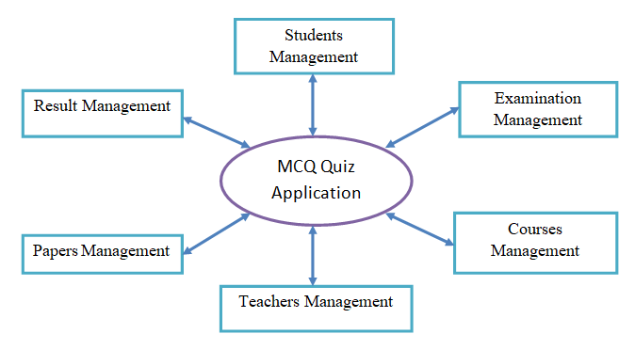
Data Flow Diagram

Slide 8
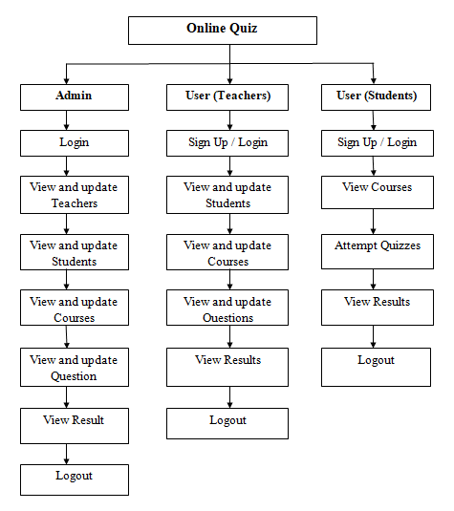
Use Case Diagram

Slide 9
Modules of Project
Home Page
Login Page
Admin Dashboard
Teachers Dashboard
Students Dashboard
Teacher Page
Student Page
Courses Page
Exam Page
Marks Page
Logout Page

Slide 10
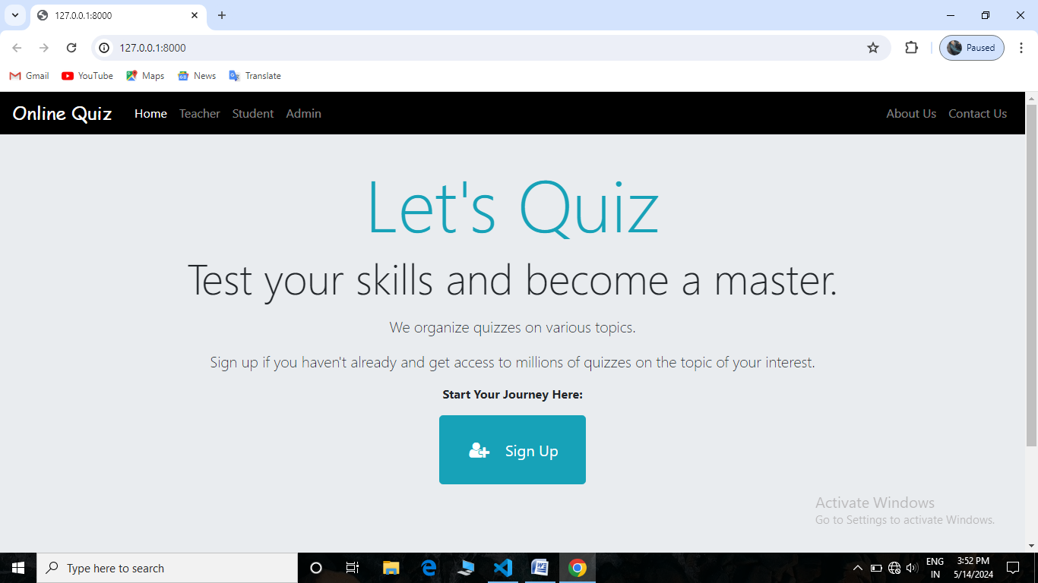
Home Page

Slide 11
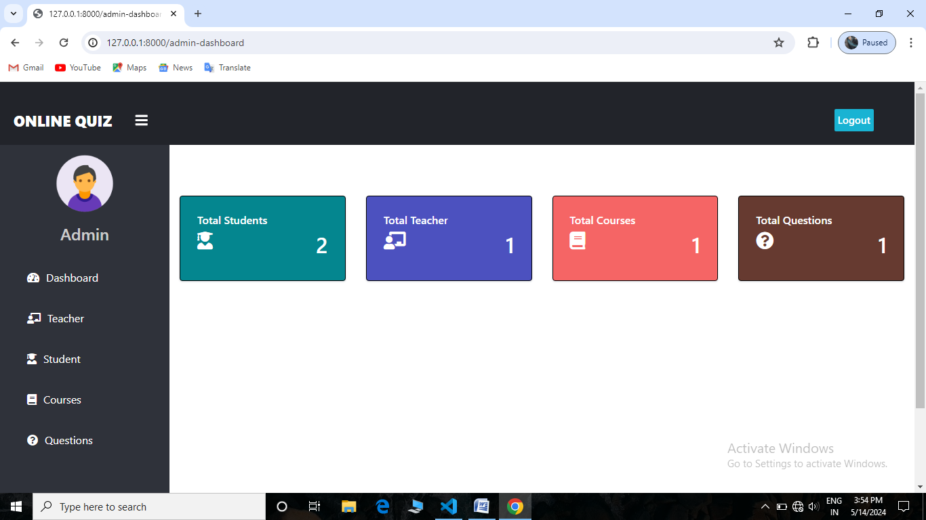
Admin’s Dashboard

Slide 12
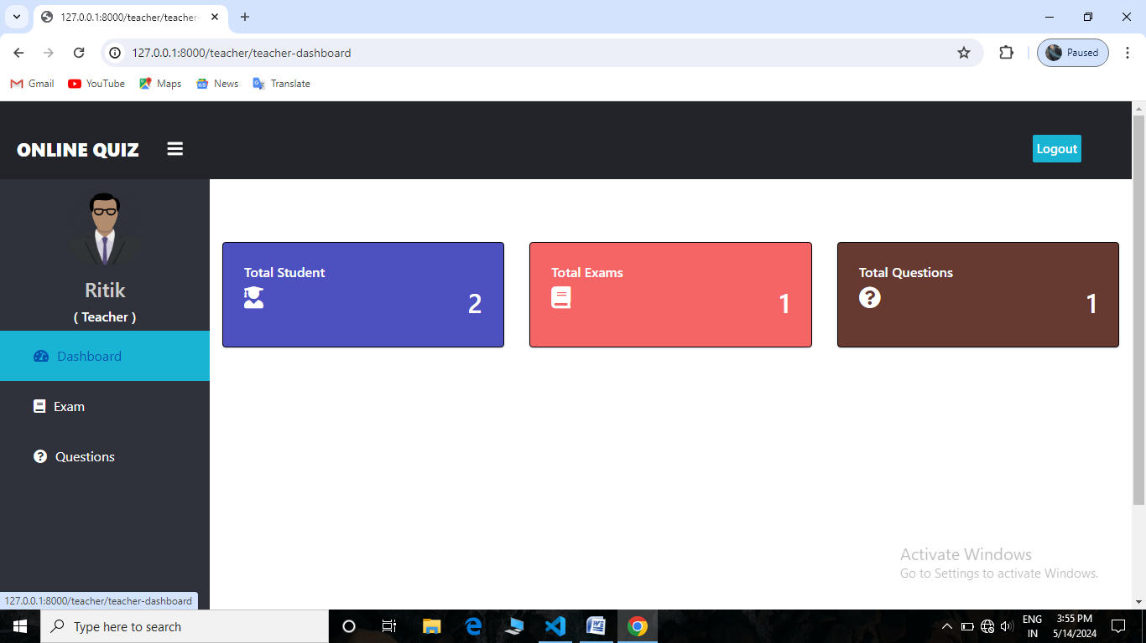
Teacher’s Dashboard

Slide 13
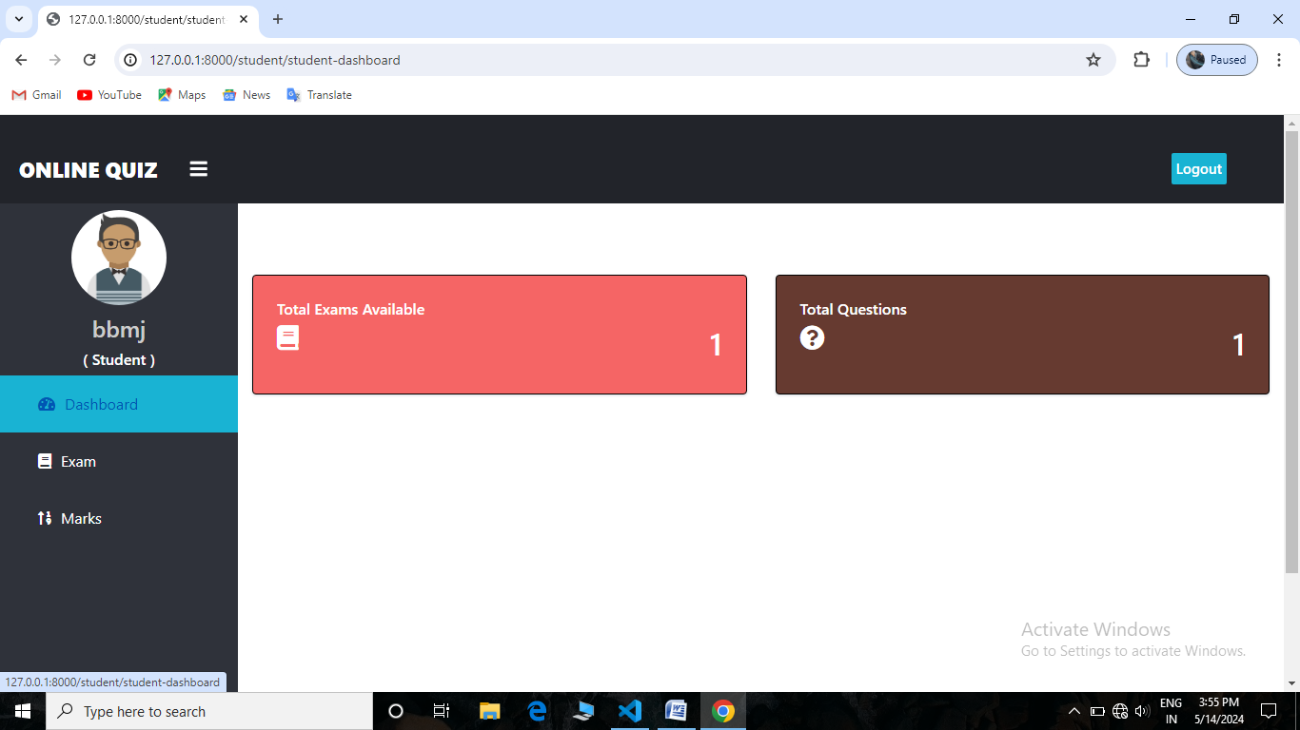
Student’s Dashboard

Slide 14
Features of Project (Admin)
After Login, admin can see Total Number Of Student, Teacher, Course, Questions are there in system on Dashboard.
Can View, Update, Delete, Approve Teacher.
Can View, Update, Delete Student.
Can Also See Student Marks.
Can Add, View, Delete Course/Exams.
Can Add Questions To Respective Courses With Options, Correct Answer, And Marks.
Can View And Delete Questions Too.

Slide 15
Features of Project (Teacher)
Apply for job in System. Then Login (Approval required by system admin, Then only teacher can login).
After Login, can see Total Number Of Student, Course, Questions are there in system on Dashboard.
Can Add, View, Delete Course/Exams.
Can Add Questions To Respective Courses With Options, Correct Answer, And Marks.
Can View And Delete Questions Too.
NOTE: Basically Admin Will Hire Teachers To Manage Courses and Questions.

Slide 16
Features of Project (Students)
Can create account (No Approval Required By Admin, Can Login After Signup)
After Login, Can See How Many Courses/Exam And Questions Are There In System On Dashboard.
Can Give Exam Any Time, There Is No Limit On Number Of Attempt.
Can View Marks Of Each Attempt Of Each Exam.
Question Pattern Is MCQ With 4 Options And 1 Correct Answer.

Slide 17
How to run this Project ?
Install Python(3.7.6) (Dont Forget to Tick Add to Path while installing Python)
Open Terminal and Execute Following Commands :
python -m pip install -r requirements. txt
Download This Project Zip Folder and Extract it
Move to project folder in Terminal. Then run following Commands :
py manage.py makemigrations
py manage.py migrate
py manage.py runserver
Now enter following URL in Your Browser Installed On Your Pc
http://127.0.0.1:8000/
CHANGES REQUIRED FOR CONTACT US PAGE
In settins.py file, You have to give your email and password
EMAIL_HOST_USER = 'youremail@gmail.com'
EMAIL_HOST_PASSWORD = 'your email password'
EMAIL_RECEIVING_USER = 'youremail@gmail.com'

Slide 18
Project Category
It is a simple and online based software.
It need lower requirements on the end user system and simplified architecture.

Slide 19
Drawbacks & Limitations
User must be computer literate
If internet is not provide then can’t be worked
Proposed Enhancements
We will make it more user friendly.
The enhancement that we can add for the searching option. We can directly search to the particular details from this site.

Slide 20
Hardware & Software Requirements
Hardware Requirements:
Software Requirements:
CPU: Single Core 2.4GHZ
RAM: 512 MB
Graphics Card: Intel or Nvidia
Hard Drive: 5GB
Processor: Pentinum
Operating System: Windows (XP, Vista, 7, 8, 10), Mac OS, Linux, Unix.
Python
Vs Code
Web Browser

Slide 21
Conclusion
The package was designed in such a way that future modifications can be done easily. The following conclusions can be deduced from the development of the project:
Automation of the entire system improves the efficiency.
It provides a friendly graphical user interface which proves to be better when compared to the existing system.
It gives appropriate access to the authorized users depending on their permissions.
It effectively overcomes the delay in communications.
Updating of information becomes so easier.
System security, data security and reliability are the striking features.

Slide 22


Slide 23


